Slide 1

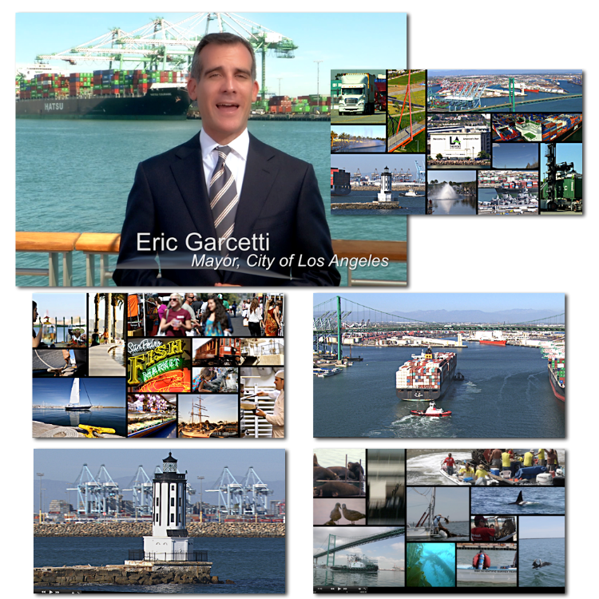
Port of
Los Angeles
America’s Port Video
Videos

